Slide 1
Localized Data Structures
Cyril Gavoille
(LaBRI, University of Bordeaux)
LOCALITY 2007
Portland, Oregon

Slide 2
Contents
Efficient data structures
Localized data structures
Informative labeling schemes
Conclusion

Slide 3
1. Efficient data structures
(Tarjan’s like)
Example 1:
A tree (static) T with n vertices
Question: nearest common ancestor nca(x,y) for some vertices x,y?
Note: queries (x,y) are not known in advance
(on-line queries on a static tree)

Slide 4
[Harel-Tarjan ’84]
Each tree with n vertices has a data structure of O(n) space (computable in linear time) such that nca queries can be answered in constant time.

Slide 5
Example 2:
A weighted graph G with n vertices, and a parameter k≥1
Question: a k-approximation δ(x,y) on dist(x,y) in G for some vertices x,y?
with dist(x,y) ≤ δ(x,y) ≤ k.dist(x,y)

Slide 6
[Thorup-Zwick - J.ACM ’05]
Each undirected weighted graph G with n vertices, and each integer k≥1, has a data structure of O(k.n^{1+1/k}) space (computable in O(km.n^{1/k}) expected time) such that (2k-1)-approximated distance queries can be answered in O(k) time.
Essentially optimal, related to an Erdös Conjecture.

Slide 7
2. Localized data structures
A network
x
Typical questions are:
Answer to query Q with the local knowledge of x (or its vicinity), so without any access to a global data structure.

Slide 8
Example 1: Distributed Hash Tables (DHT)
set of peers
logical network
x
Query at x: who has any mpeg file named ‘‘Sta*Wa*’’?
Answer: go to w and ask it.
x does not know, but w certainly knows … at least a pointer

Slide 9
Example 2: Routing in a physical network
x
y
Query at x: next hop to go to y?

Slide 10
Example 3: in a dynamic setting
A growing rooted tree
Query at x: the number of descents of x
(or a constant approximation of it)
[Afek,Awerbuch,Plokin,Saks – J.ACM ’96]
It is possible to maintain a 2-approximation on the number of descendants with O(log²n) amortized messages of O(loglogn) bits each, n number of inserted vertices.

Slide 11
Goals are:
The same as for global data structures:
  Low preprocessing time
  Small size data structure
  Fast query time
  Efficient updates
+ Smaller and balanced local data structures
+ Low communication cost (trade-offs), for multiple hops answers

Slide 12
3. Informative Labeling Schemes
For the talk
  A static network/graph
  Queries: involve only vertices
  Answers: do not require any communication (direct data structures)

Slide 13
Question: dist(x,y) in a graph G?
(with localized data structure)
data structure
for graph G
x
y
Answering to dist(x,y) consists only in inspecting the local data structure of x and of y.
Main goal: minimize the maximal size of a local data structure. Wish: |DS(x,G)| « |DS(G)|, ideally
|DS(x,G)| ≈ (1/n).|DS(G)|

Slide 14
[Thorup-Zwick - J.ACM ’05]
… Moreover, each vertex w → L(w) of Õ(n^{1/k}) bits such that a (2k-1)-approximation on dist(x,y) can be answered from L(x) and L(y) only.
n^{1+1/k}
w
x
y
Overlap: Õ(1)
n^{1/k}

Slide 15
Informative Labeling Schemes
(more formally) [Peleg ’00]
Let P be a graph property defined on pairs of vertices (can be extended to any tuple), and let F be a graph family.
A P-labeling scheme for F is a pair ‹L,f› such that: ∀ G ∈ F , ∀u,v∈ G:
  (labeling) L(u,G) is a binary string
  (decoder) f(L(u,G),L(v,G)) = P(u,v,G)

Slide 16
Some P-labeling schemes
Adjacency
Distance (exact or approximate)
First edge on a (near) shortest path (compact routing, labeled-based routing)
Ancestry, parent, nca, sibling relation in trees
Edge/vertex connectivity, flow
Proof labeling systems [Korman, Kutten, Peleg]
Small-world & navigability
Forbidden set [Courcelle, Twigg]

Slide 17
Ancestry in rooted trees
Motivation: [Abiteboul,Kaplan,Milo ’01]
The <TAG> … </TAG> structure of a huge XML data-base is a rooted tree. Some queries are ancestry relations in this tree.
Use compact index for fast query XML search engine. Here the constants do matter. Saving 1 byte on each entry of the index table is important. Here n is very large, ~ 10⁹.
Ex: Is <“distributed computing”> descendant
of <book_title>?

Slide 18
Folklore? [Santoro, Khatib ’85]
DFS labeling
1
[22,27]
L(x)=[2,18]
19
8
27
20
21
3
23
24
7
10
25
26
9
[13,18]
4
5
6
11
12
15
18
[a,b] ⊆ [c,d]?
14
17
16
⇒ 2logn bit labels

Slide 19
[Alstrup,Rauhe – Siam J.Comp. ’06]
Upper bound: logn + O(√logn) bits
Lower bound: logn + Ω(loglogn) bits
1
22
2
19
8
27
20
21
3
23
24
7
10
25
26
9
13
4
5
6
11
12
15
18
14
17
16

Slide 20
Adjacency Labeling /
Implicit Representation
P(x,y,G)=1 iff xy in E(G)
[Kanan,Naor,Rudich – STOC ’92]
O(logn) bit labels for:
  trees (and forests)
  bounded arboricity graphs (planar, …)
  bounded treewidth graphs
In particular:
  2logn bits for trees
  4logn bits for planar

Slide 21
Acutally, the problem is equivalent to an old combinatorial problem:
[Babai,Chung,Erdös,Graham,Spencer ’82]
Small Universal Induced Graph
U is an universal graph for the family F if every graph of F is isomorphic to an induced subgraph of U
b
b
f
c
a
g
e
c
a
g
c
g
d
e
e

Slide 22
b
b
f
c
a
g
e
c
a
g
c
g
d
e
e
Universal graph U
(fixed for F)
Graph G of F
|L(x,G)| = ⎡log₂|V(U)|⎤

Slide 23
Best known results/Open questions
Bounded degree graphs: 1.867 logn
  [Alon,Asodi - FOCS ’02]
Trees: logn + O(log*n)
  [Alstrup,Rauhe - FOCS ’02]
⇒ Planar: 3logn + O(log*n)
Planar: 2logn + O(loglogn)
[Gavoille,Labourel - ESA ’07]
Z
x
v
y
log*n = min{ i≥0 | log^{(i)}n≤ 1}

Slide 24
Lower bounds?: logn + Ω(1) for planar
No hereditary family with n!2^{O(n)} labeled graphs (trees, planar, bounded genus, bounded treewidth,…) is known to require labels of logn + ω(1) bits.
logn + O(1) bits for this family?

Slide 25
Distance
P(x,y,G)=dist(x,y) in G
Motivation: [Peleg ’99]
If a short label (say of polylogarithmic size) can be added to the address of the destination, then routing to any destination can be done without routing tables and with a “limited” number of messages.
x
dist(x,y)
y
message header=hop-count

Slide 26
A selection results
Θ(n) bits for general graphs
  1.56n bits, but with O(n) time decoder!
    [Winkler ’83 (Squashed Cube Conjecture)]
  11n bits and O(loglogn) time decoder
    [Gavoille,Peleg,Pérennès,Raz ’01]
Θ(log²n) bits for trees and bounded treewidth graphs, … [Peleg ’99, GPPR ’01]
Θ(logn) bits and O(1) time decoder for interval, permutation graphs, … [ESA ’03]: ⇒ O(n) space O(1) time data structure, even for m=Ω(n²)

Slide 27
Results (cont’d)
Θ(logn.loglogn) bits and (1+o(1))-approximation for trees and bounded treewidth graphs
[GKKPP – ESA ’01]
More recently: doubling dimension-α graphs
Every radius-2r ball can be covered by ≤ 2^{α} radius-r balls
Euclidean graphs have α=O(1)
Include bounded growing graphs
Robust notion

Slide 28
Distance labeling for doubling dimension-α graphs
Ο(ε^{-O(α)} logn.loglogn) bits
(1+ε)-approximation for doubling dimension-α graphs
[Gupta,Krauthgamer,Lee – FOCS ’03]
[Talwar – STOC ’04]
[Mendel,Har-Peled – SoCG ’05]
[Slivkins - PODC ’05]

Slide 29
Distance labeling for planar
O(log²n) bits for 3-approximation
[Gupta,Kumar,Rastogi – Siam J.Comp ’05]
O(ε⁻¹log²n) bits for (1+ε)-approximation
[Thorup – J.ACM ’04]
Ω(n^{1/3}) ≤ ? ≤ Õ(√n) for exact distance
O(ε⁻¹log²n) bits for (1+ε)-approximation for graphs excluding a fixed minor (K₅,K₆,…)
[Abraham,Gavoille – PODC ’06]

Slide 30
Small-World & Navigability
[Kleinberg]
t
u
v
Augmented graph: (G,P) [base graph,distributions]
P(u,v) = Pr(u has v as long range contact)
Greedy Routing: closest neighbor (in G)
Expected number of hops (according to P)

Slide 31
Small-World & Navigability
t
u
v
Uniform distribution: P(u,v)=1/n
r-harmonic distribution: P(u,v) ∝ 1/d(u,v)^{r}
Note: for harmonic need to know distances in G in order to compute P

Slide 32
Small-World & Navigability
How much complicated is P?
Design a “simple” distribution with a low expected number of hops for G
k-navigability labeling scheme
is a labeling scheme <L,f> st: ∀u,v of G
P(u,v)=f(L(u,G),L(v,G))
Expected #hops ≤ k

Slide 33
Navigability: Results
All graphs [uniform]:
O(√n)-navigability with ⎡logn⎤-bit labels
Grids [in DISC ’05]:
O(logn)-navigability with ⎡logn⎤-bit labels
Trees [Fraigniaud et al.]:
O(log²n)-navigability with O(log²n) bits
O(log³n)-navigability with ⎡logn⎤ bits

Slide 34
Navigability: Results (cont’d)
Bounded path-shape graphs [SPAA ‘07]:
O(ps(G)·log²n)-navigability with ⎡logn⎤ bits
[bounded tree-width, bounded path-length, AT-free, permutation, interval graphs … have ps=O(logn)]
All graphs:
Õ(n^{1/3})-navigability, but with O(n) bits!
Questions:
- smallest k=k(n) for k-navigability ∀graphs
currently: c^{√logn} ≤ k ≤ Õ(n^{1/3})
- o(√n)-navigability with polylog(n) labels

Slide 35
Forbidden-Set Labeling
[Courcelle,Twigg ‘07]
Problem:
Design a routing scheme for G st for every subset X of “forbidden” nodes (crashes, malicious, …) routing tables can be updated efficiently provided X.
⇒ This capture routing policies
Extension: Forbidden-set P-labeling
<L,f> st ∀X, P(u,v,G\X)=f(L(u,G),L(u,G),L(X,G))

Slide 36
Forbidden-Set Labeling: Results
Example:
Connectivity in trees: P(u,v,T\X)=TRUE iff u and v are in the same connected component of T\X.
⇒ can be done with O(logn)-bit labels.
[Courcelle, Twigg – STACS ‘07]
If G has bounded “clique-width” (generalization of tree-width) and every monadic second order predicate P (distances, connectivity, …) then labels of O(log²n)-bit suffice.
Note: same (optimal) bounds for distances in trees as the static case, but do not include planar …

Slide 37
Conclusion
Labeling scheme for distributed computing is a rich concept.
Many things remain to do, specially lower bounds

Slide 38
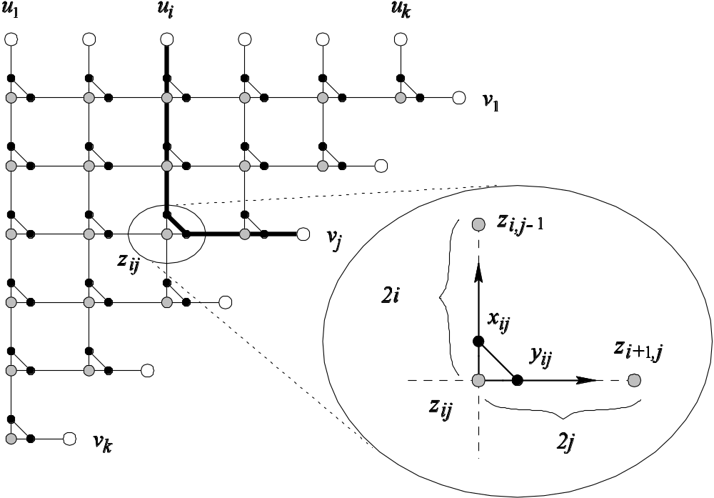
Lower bounds for planar
[Gavoille,Peleg,Pérennès,Raz – SODA ’01]
n=#vertices ~ k³
#critical edges ~ k²
#labels =2k
⇒ ∃ |label|> k²/ 2k ~ n^{1/3}

Slide 39
Proof Labeling Systems
[Korman,Kutten,Peleg – PODC ’05]
A graph G with a state S_{u} at each vertex u: (G,S)
A global property P (MST, 3-coloring, …)
A marker algorithm applied on (G,S) that returns a label L(u) for u
A binary decoder (checker) for u applied on N(u):
f_{u} = f(S_{u},L(u),L(v₁)…L(v_{k})) ∈ {0,1}
  G has property P ⇒ f_{u}=1 ∀u
  G hasn't prop. P ⇒ ∃w, f_{w}=0 whatever the labels are
S₁
v₁
v₃
S₂
u
S₅
S₃
v₂
S₄

Slide 40
What is the knowledge needed for local verifications of global properties?
S₁
S₂
S₅
S₃
S₄

